Slide 1
Positivism
Interpretivism

Slide 2
A Brief Overview
Positivism
Interpretivism
Scientific study of society
Structure comes first
Reaction to modernity
Emphasis on socialisation
Follows explicit and transparent procedures or methods
Careful measurement of phenomena
Generally leads to quantitative research methods
Personal study of society
Individual comes first
Reaction to modernity
Emphasis on voluntary actions
Focuses on how people interpret and make sense of their world
Collect data in a relatively open-ended fashion
Generally leads to qualitative research methods

Slide 3
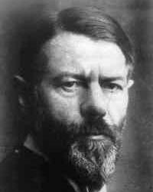
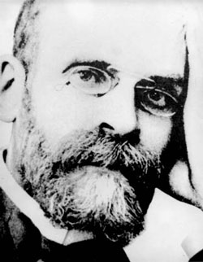
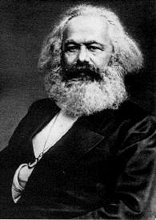
A Rough Guide to Key Approaches
Positivism
Interpretivism
Structural - Consensus
Weber
Anti-deterministic
Durkheim
Structural - Conflict
Marx

Slide 4
Positivism
Structural-Consensus
Structural-Conflict
Human behaviour is learnt behaviour (socialisation).
A society’s cultural rules determine, or structure, the behaviour of its members, channelling their actions in certain ways rather than others.
E.G. uniformed services or school children
Different groups within society possess unequal amounts of power, authority, wealth, etc.
The origin and persistence of a structure of inequality lies in the domination of its disadvantaged groups by its advantaged ones.
E.G. work or education
Notes:
Bottom left picture is Durkheim
Bottom right picture is Marx

Slide 5
Interpretivism
Stress the focus on micro-level rather than the macro-level.
Society does not and must not exist outside of or prior to the interaction of individuals.
We choose what to do in the light of our ‘definition of the situation’.
E.G. the way we dress or act
Notes:
Picture is Max Weber

Slide 6
Blurred Generalisations
Generally structural theorists are more likely to support scientific methods and procedures to produce data about human behaviour.
These are more likely to be positivists.
Interpretivists are more likely to be anti-positivist (or anti-structuralist).
Generally argue the methods and procedures of science are wholly inappropriate for the study of human social life.

Slide 7

Do You Think You Are More Positivist or Interpretivist?
Spend a couple of minutes to go through your notes, etc and think about what school of thought you are in.
Speak to the person next to you for help if needed
Provide some reasons why you think you are this
Getting an early understanding of what school of thought you are likely to be in will help you when exploring Sociology and Sociological research.
You may end up changing your position throughout this course
That’s ok.

Slide 8
Complete the Worksheet
5 Minutes
Once completed pass your answers to someone else who will grade it
The marker will put the correct answer next to the point
If there are any wrong answers, don’t worry
Go onto the VLE/Moodle and download the Positivism and Interpretivism worksheet and correctly fill it in.

